Slide 1
One- and Two-Sample Estimation Problems:
Introduction:
· Suppose we have a population with some unknown parameter(s).
Example: Normal(μ,σ)
μ and σ are parameters.
· We need to draw conclusions (make inferences) about the unknown parameters.
· We select samples, compute some statistics, and make inferences about the unknown parameters based on the sampling distributions of the statistics.
* Statistical Inference
(1) Estimation of the parameters
→ Point Estimation
→ Interval Estimation (Confidence Interval)
(2) Tests of hypotheses about the parameters

Slide 2








Classical Methods of Estimation:
Point Estimation:
A point estimate of some population parameter θ is a single value of a statistic . For example, the value of the statistic
computed from a sample of size n is a point estimate of the population mean μ.
Interval Estimation (Confidence Interval = C.I.):
An interval estimate of some population parameter θ is an interval of the form ( , ), i.e, <θ< . This interval contains the true value of θ "with probability 1−α", that is P( <θ< )=1−α
( , ) = <θ< is called a (1−α)100% confidence interval (C.I.) for θ.
1−α is called the confidence coefficient
= lower confidence limit
= upper confidence limit
α =0.1, 0.05, 0.025, 0.01 (0<α<1)

Slide 3
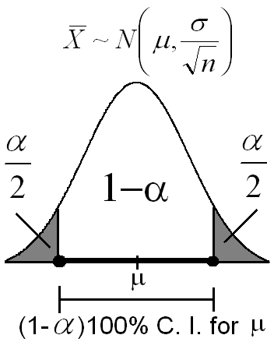
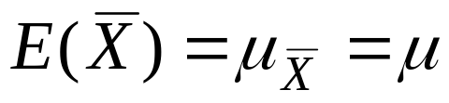
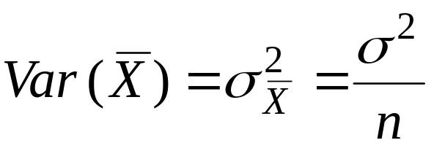
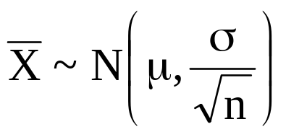
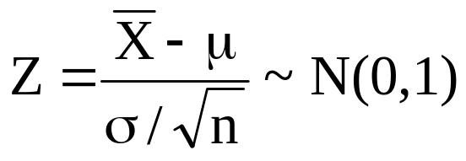
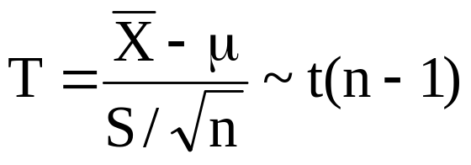

Single Sample: Estimation of the Mean (μ):
Recall:
(σ² is known)
(σ² is unknown)
We use the sampling distribution of to make inferences about μ.

Slide 4
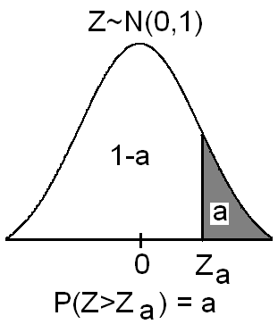
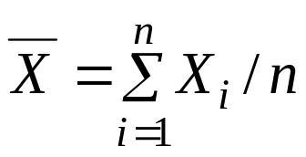
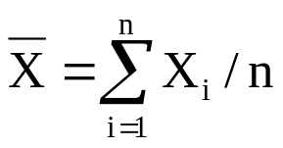
Notation:
Z_{a} is the Z-value leaving an area of a to the right; i.e., P(Z>Z_{a})=a or equivalently, P(Z<Z_{a})=1−a
Point Estimation of the Mean (μ):
· The sample mean is a "good" point estimate for μ.
Interval Estimation (Confidence Interval) of the Mean (μ):
(i) First Case: σ² is known:
Result:
If is the sample mean of a random sample of size n
from a population (distribution) with mean μ and known variance σ², then a (1−α)100% confidence interval for μ is :

Slide 5
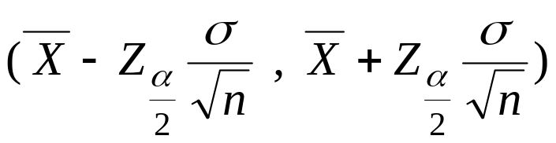
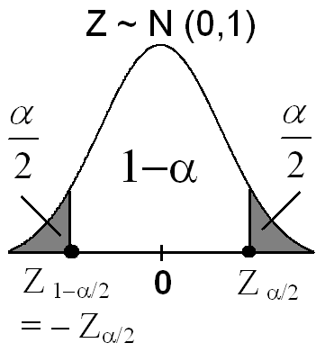
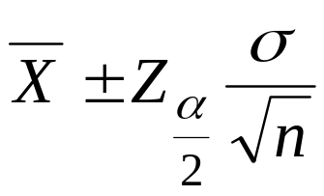
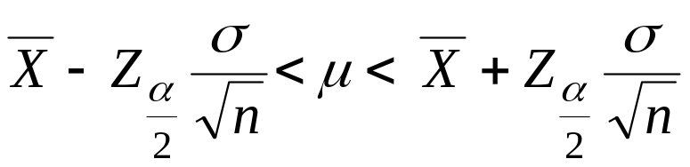
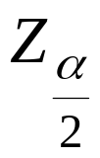
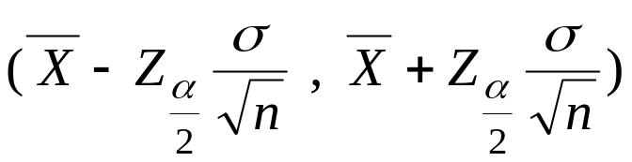
⇔
⇔
where is the Z-value leaving an area
of α/2 to the right; i.e., P(Z> )=α/2, or
equivalently, P(Z< )=1−α/2.
Note:
We are (1−α)100% confident that μ ∈

Slide 6
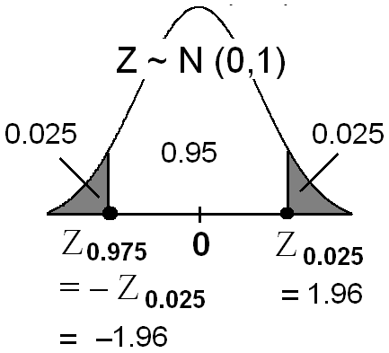
Example 1:
The average zinc concentration recorded from a sample of zinc measurements in 36 different locations is found to be 2.6 gram/milliliter. Find a 95% and 99% confidence interval (C.I.) for the mean zinc concentration in the river. Assume that the population standard deviation is 0.3.
Solution:
= the mean zinc concentration in the river.
Population Sample
μ=?? n=36
σ=0.3 =2.6
First, a point estimate for μ is =2.6.
(a) We want to find 95% C.I. for μ.
α = ??
95% = (1−α)100%
⇔ 0. 95 = (1−α)
⇔ α=0.05
⇔ α/2 = 0.025

Slide 7
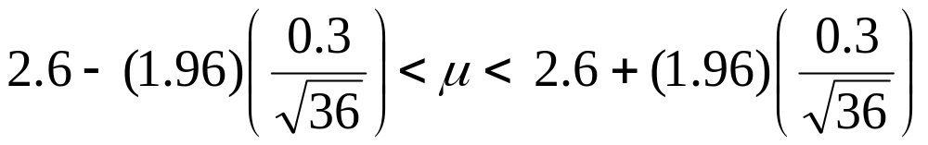
= Z_{0.025}
= 1.96
A 95% C.I. for μ is
⇔
⇔
2.6 − 0.098 < μ < 2.6 + 0.098
⇔ 2.502 < μ < 2.698
⇔ μ ∈( 2.502 , 2.698)
We are 95% confident that μ ∈( 2.502 , 2.698).

Slide 8

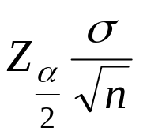
(b) Similarly, we can find that (Homework) A 99% C.I. for μ is
2.471 < μ < 2.729
⇔ μ ∈( 2.471 , 2.729)
We are 99% confident that μ ∈( 2.471 , 2.729)
Notice that a 99% C.I. is wider that a 95% C.I..
Note:
Error
|-----------|
______|____________________________|____
|----------------------|--------------------------|
Theorem 9.1:
If is used as an estimate of
μ, we can then be (1−α)100% confident that the error (in
estimation) will not exceed

Slide 9

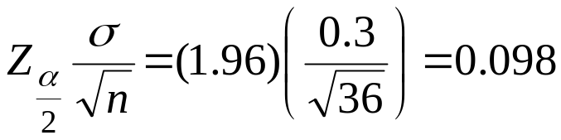
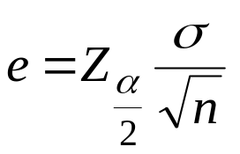
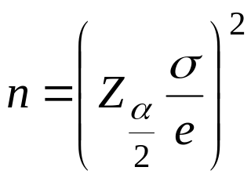
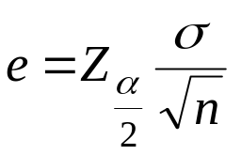
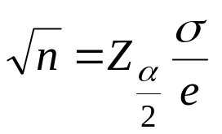
Example:
In Example 1, we are 95% confident that the sample mean differs from the true mean μ by an amount less than
Note:
Let e be the maximum amount of the error, that is ,
then:
⇔
⇔
Theorem:
If is used as an estimate of μ, we can then be (1−α)100% confident that the error (in estimation) will not exceed a specified
amount e when the sample size is

Slide 10
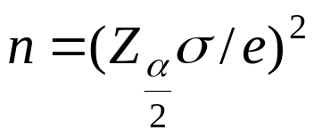
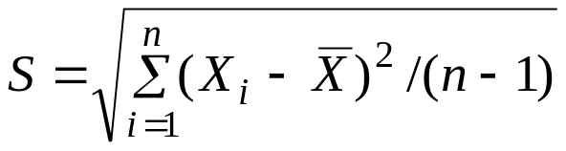
Note:
1. All fractional values of are rounded up to the next whole number.
2. If σ is unknown, we could take a preliminary sample of size n≥30 to provide an estimate of σ. Then using
as an approximation for σ.
we could determine approximately how many observations are needed to provide the desired degree of accuracy.
Example 9.3:
How large a sample is required in Example 9.2 if we want to be 95% confident that our estimate of μ is off by less than 0.05?

Slide 11
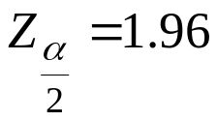
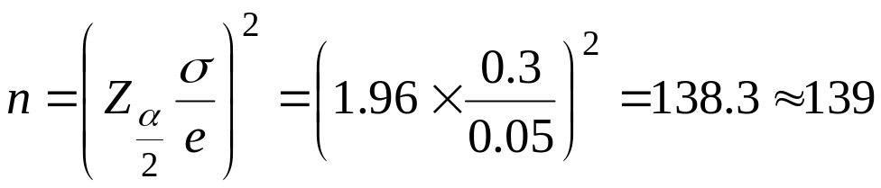
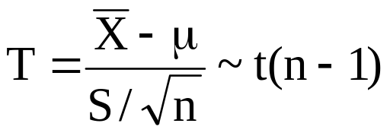
Solution:
We have σ= 0.3 , , e=0.05. Then by Theorem 9.2,
Therefore, we can be 95% confident that a random sample of size n=139 will provide an estimate differing from μ by an amount less than e=0.05.
Interval Estimation (Confidence Interval) of the Mean (μ):
(ii) Second Case: σ² is unknown:
Recall:

Slide 12
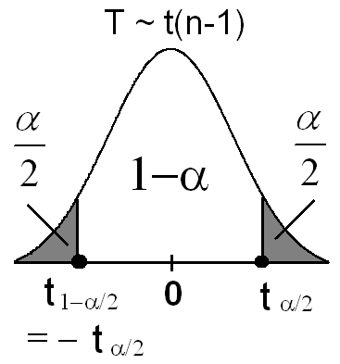
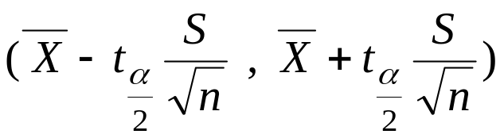
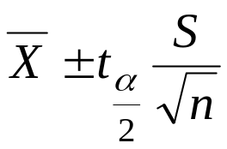
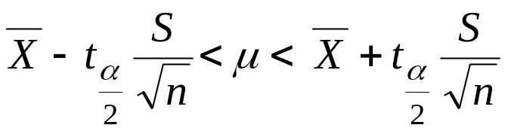
Result:
If and are the sample mean
and the sample standard deviation of a random sample of size n from a normal population (distribution) with unknown variance σ², then a (1−α)100% confidence interval for μ is :

Slide 13

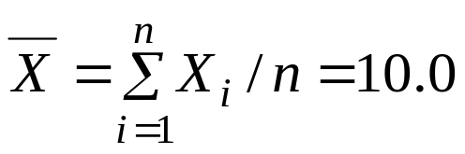
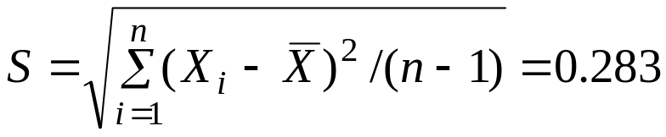
where is the t-value with ν=n−1 degrees of freedom leaving
an area of α/2 to the right; i.e., P(T> )=α/2, or equivalently, P(T< )=1−α/2.
Example 2:
The contents of 7 similar containers of sulfuric acid are 9.8, 10.2, 10.4, 9.8, 10.0, 10.2, and 9.6 liters. Find a 95% C.I. for the mean of all such containers, assuming an approximate normal distribution.
Solution:
.n=7
First, a point estimate for μ is

Slide 14


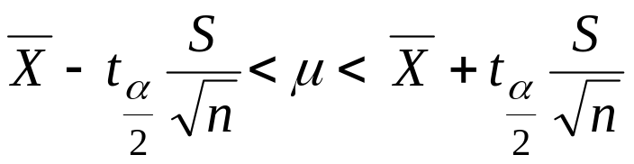
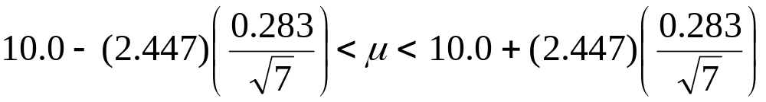
Now, we need to find a confidence interval for μ.
α = ??
95%=(1−α)100% ⇔ 0. 95=(1−α) ⇔ α=0.05 ⇔ α/2=0.025
= t_{0.025} =2.447 (with ν=n−1=6 degrees of freedom)
A 95% C.I. for μ is
 | 0.025
6 | ↓ → t_{0.025}=2.447
⇔
⇔
⇔ 10.0 − 0.262< μ < 10.0 + 0.262
⇔ 9.74 < μ < 10.26
⇔ μ ∈( 9.74 , 10.26)
We are 95% confident that μ ∈( 9.74 , 10.26).

Slide 15
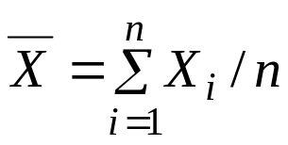
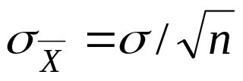

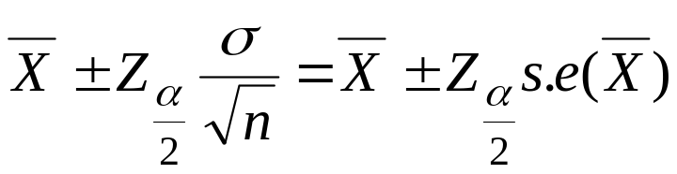
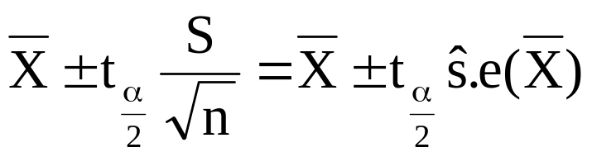
Standard Error of a Point Estimate:
· The standard error of an estimator is its standard deviation.
· We use as a point estimator of μ, and we used
the sampling distribution of to make a (1−α)100% C.I. for μ.
· The standard deviation of , which is ,is called the standard error of . We write s.e.
· Note: a (1−α)100% C.I. for μ, when σ² is known, is
· Note: a (1−α)100% C.I. for μ, when σ² is unknown and the distribution is normal, is
(ν=n−1 df)

Slide 16
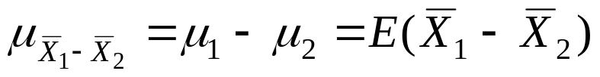
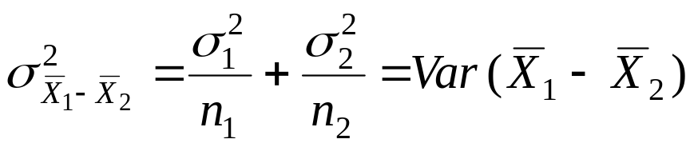
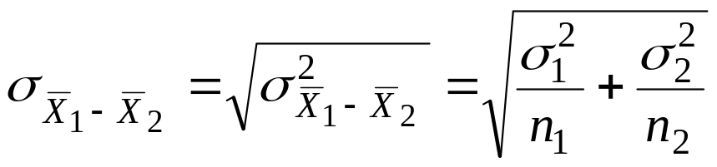
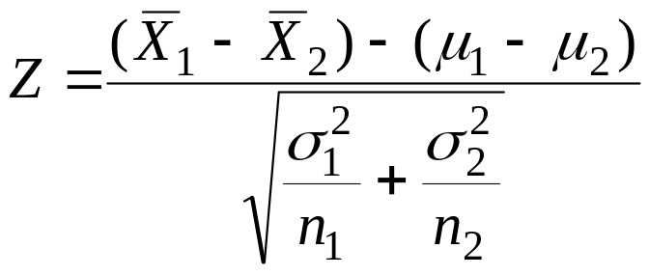
Two Samples: Estimating the Difference between Two Means (μ₁−μ₂):
Recall: For two independent samples:
~N(0,1)

Slide 17



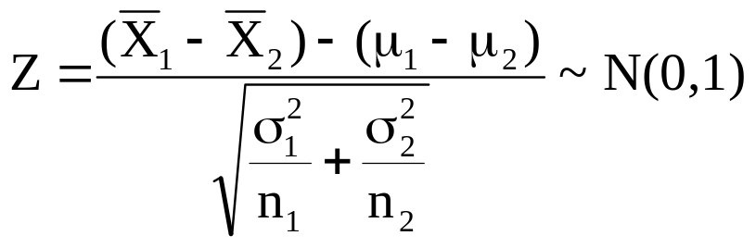
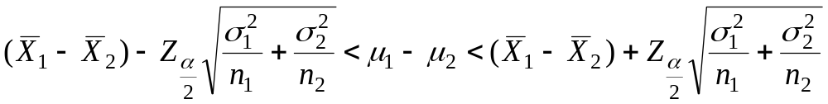
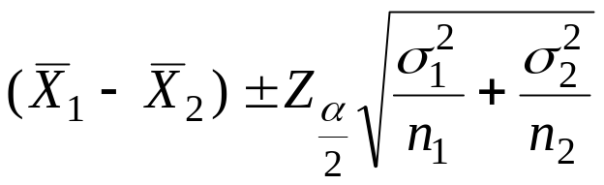
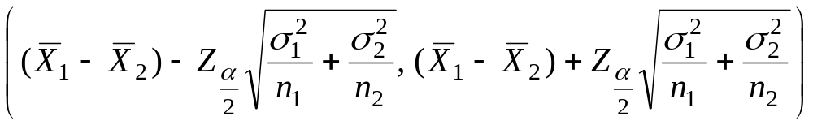
Point Estimation of μ₁−μ₂:
is a "good" point estimate for μ₁−μ₂.
Confidence Interval of μ₁−μ₂:
(i) First Case: and are known:
Result:
a (1−α)100% confidence interval for μ₁−μ₂ is :
or
or

Slide 18

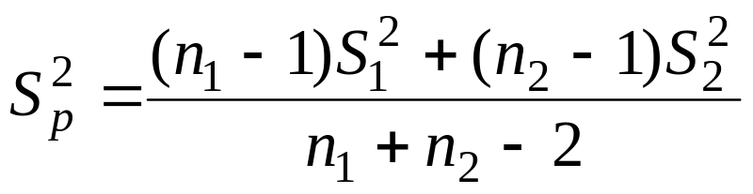



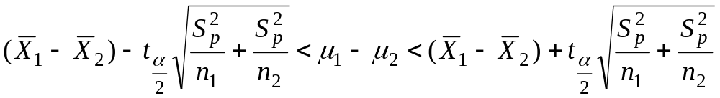

(ii) Second Case: = =σ² is unknown:
If and are unknown but = =σ², then the pooled estimate of σ² is
where is the variance of the 1-st sample and is the variance of the 2-nd sample. The degrees of freedom of is ν=n₁+n₂−2.
Result:
a (1−α)100% confidence interval for μ₁−μ₂ is :
or

Slide 19


or
or
where is the t-value with ν=n₁+n₂−2 degrees of freedom.

Slide 20
Example: (1st Case: and are known)
An experiment was conducted in which two types of engines, A and B, were compared. Gas mileage in miles per gallon was measured. 50 experiments were conducted using engine type A and 75 experiments were done for engine type B. The gasoline used and other conditions were held constant. The average gas mileage for engine A was 36 miles per gallon and the average for engine B was 42 miles per gallon. Find 96% confidence interval for μ_{B}−μ_{A}, where μ_{A} and μ_{B} are population mean gas mileage for engines A and B, respectively. Assume that the population standard deviations are 6 and 8 for engines A and B, respectively.

Slide 21





Solution:
Engine A Engine B
n_{A}=50 n_{B}=75
=36 =42
σ_{A}=6 σ_{B}=8
A point estimate for μ_{B}−μ_{A} is =42−36=6.
α = ??
96% = (1−α)100% ⇔ 0. 96 = (1−α) ⇔ α=0.04 ⇔ α/2 = 0.02
= Z_{0.02} = 2.05
A 96% C.I. for μ_{B}−μ_{A} is

Slide 22



3.43 < μ_{B}−μ_{A} < 8.57
We are 96% confident that μ_{B}−μ_{A} ∈(3.43, 8.57).

Slide 23


To compare the resistance of wire A with that of wire B, an experiment shows the following results based on two independent samples (original data multiplied by 1000):
Wire A: 140, 138, 143, 142, 144, 137
Wire B: 135, 140, 136, 142, 138, 140
Assuming equal variances, find 95% confidence interval for μ_{A}−μ_{B}, where μ_{A} (μ_{B}) is the mean resistance of wire A (B).
Solution:
Wire A Wire B .
n_{A}=6 n_{B}=6
S²_{A}=7.86690
S²_{B}=7.10009
____________________________________

Slide 24






A point estimate for μ_{A}−μ_{B} is =140.67−138.50=2.17.
95% = (1−α)100% ⇔ 0. 95 = (1−α) ⇔ α=0.05 ⇔ α/2 = 0.025
ν= df = n_{A}+n_{B} − 2= 10
= t_{0.025} = 2.228
A 95% C.I. for μ_{A}−μ_{B} is

Slide 25



or
−1.35< μ_{A}−μ_{B} < 5.69
We are 95% confident that μ_{A}−μ_{B} ∈(−1.35, 5.69)

